Slide 1
Concurrency

Slide 2




Concurrency
Definition: several scripts are executing simultaneously and potentially interacting with each other.
This is how we assign grades! Based on the Birkahni Theorem, we usually get the grades to average to a B+, though due to the size of the class this semester, the average will be a C+ (jk)

Slide 3
Race Condition
1
Concurrency Issue

Slide 4
Race Condition
Definition:
When events of a program don’t happen in the order that the programmer intended.
http://snap.berkeley.edu/snapsource/snap.html#present:Username=laralinmcc&ProjectName=withdraw
Notes:
Do Worksheet problem

Slide 5
What if we interleaved the commands?

Slide 6


Race Condition - Example
 |  | (Global Integer Value)
 |  | 0
‘num’ starts out with the value 0

Slide 7

Race Condition - Example
 |  | (Global Integer Value)
 |  | 0
 |  | 0
Read Value - reads the value of ‘num’ and sets ‘temp1’ to that value

Slide 8

Race Condition - Example
 |  | (Global Integer Value)
 |  | 0
 |  | 0
 |  | 0
Read Value - reads the value of ‘num’ and sets ‘temp2’ to that value

Slide 9

Race Condition - Example
 |  | (Global Integer Value)
 |  | 0
 |  | 0
 |  | 0
 |  | 0
Increments Value - increases the value of ‘temp1’ by 1

Slide 10

Race Condition - Example
 |  | (Global Integer Value)
 |  | 0
 |  | 0
 |  | 0
 |  | 0
 |  | 0
Increments Value - increases the value of ‘temp2’ by 2

Slide 11

Race Condition - Example
 |  | (Global Integer Value)
 |  | 0
 |  | 0
 |  | 0
 |  | 0
 |  | 0
 |  | 1
Sets Value - sets ‘num’ to the value of ‘temp1’, which is 1

Slide 12

Race Condition - Example
 |  | (Global Integer Value)
 |  | 0
 |  | 0
 |  | 0
 |  | 0
 |  | 0
 |  | 1
 |  | 2
Sets Value - sets ‘num’ to the value of ‘temp2’, which is 2

Slide 13
Race Condition - Example
 |  | (Global Integer Value)
 |  | 0
 |  | 0
 |  | 0
 |  | 0
 |  | 0
 |  | 1
 |  | 2
This is NOT the expected output. ‘num’ is only 2!

Slide 14
Takeaway
Concurrency is great because it allows for tasks to be broken up and completed almost simultaneously. However, you have to be careful how you break up the tasks so you don’t get erroneous behavior.

Slide 15
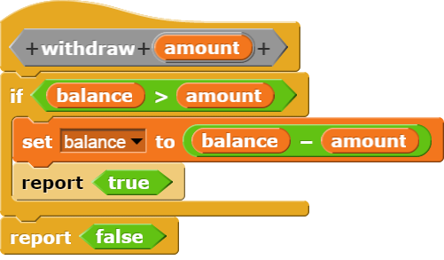
Race Condition Example: Withdrawing
What if two people were calling withdraw at the same time?
e.g., balance = 100 and two withdrew 75 each
Can anyone see what the problem could be?
This is a race condition.
In most languages, this is a problem.
In Scratch, the system doesn’t let two of these run at once.

Slide 16
Deadlock
3

Slide 17
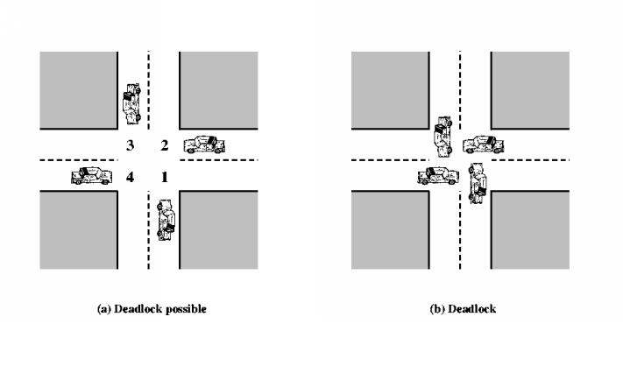
Deadlock
Definition:
A situation in which two or more competing actions are each waiting for the other(s) to finish, and thus no one ever finishes.
Deadlock Possible
Deadlock
Notes:
http://snap.berkeley.edu/snapsource/snap.html#present:Username=laralinmcc&ProjectName=Deadlock

Slide 18
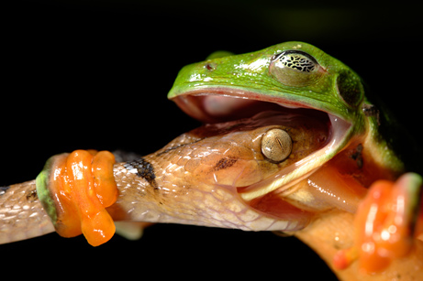
Deadlock Example
Notes:
According to photographer, locked like this for 3 hours. he didn’t stick around to see who won…
Article can be found here

Slide 19
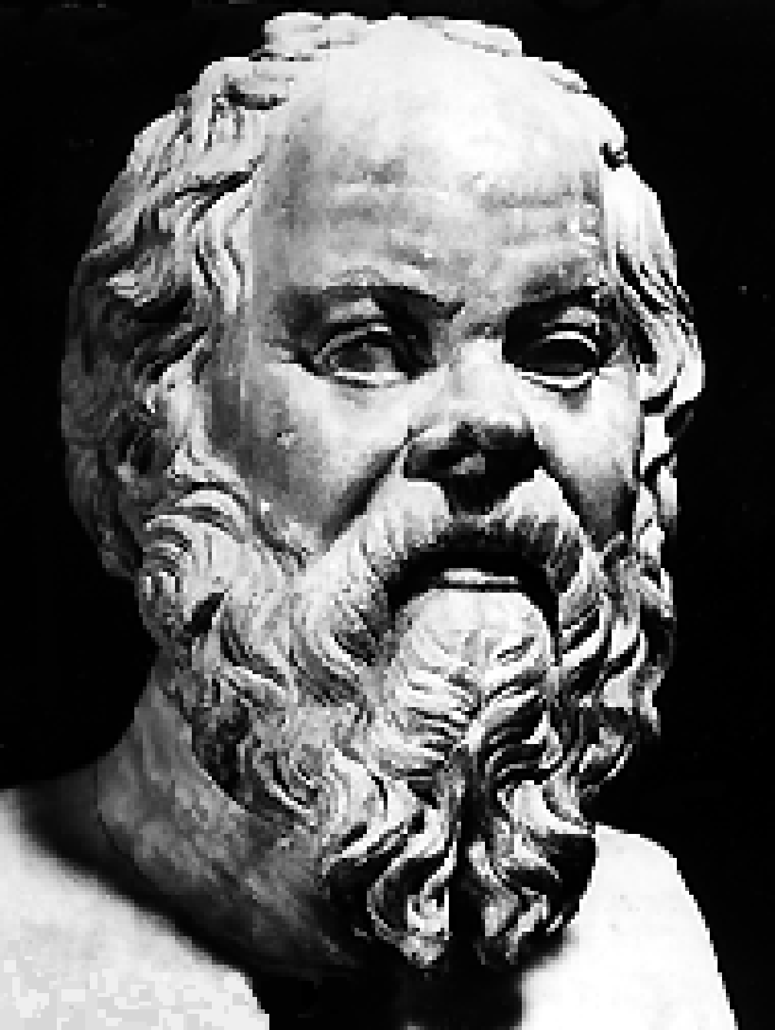
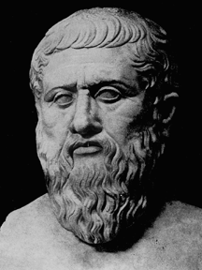

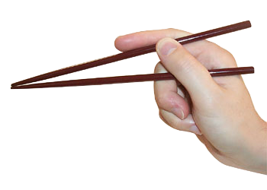
Dining Philosopher Problem

Slide 20
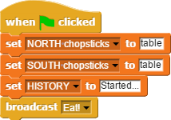
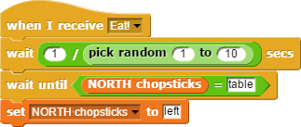
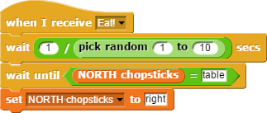
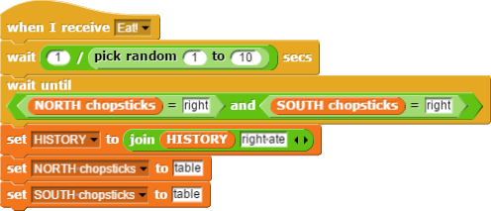

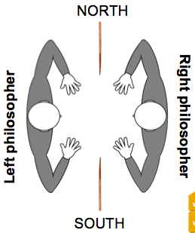
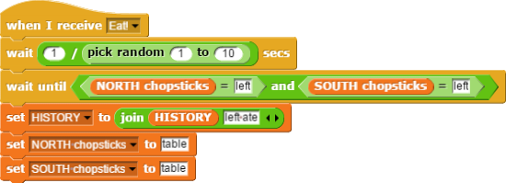
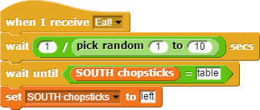
Question 12: Dining Philosophers (5 pts)
Two philosophers (left and right) are having dinner, sitting across from each other. There is a NORTH and a SOUTH chopstick on the table. Each philosopher continually looks down to see if a chopstick is on the table, and tries to grab it; if both are ever grabbed by one person, that person eats, updates HISTORY (a record of what happened) and puts the chopsticks down. Ten seconds after the green flag is clicked, what should HISTORY be?

Slide 21
Question 12: Dining Philosophers (5 pts)
Started…, Left ate…, Right ate…
Started…, Right ate…, Left ate…
Started…

